Slide 1
Group 5 – Loss tracking
Pranav, Toby, Anton, Craig, Evelyn
RAL Visitor Centre
07.07.23

Slide 2

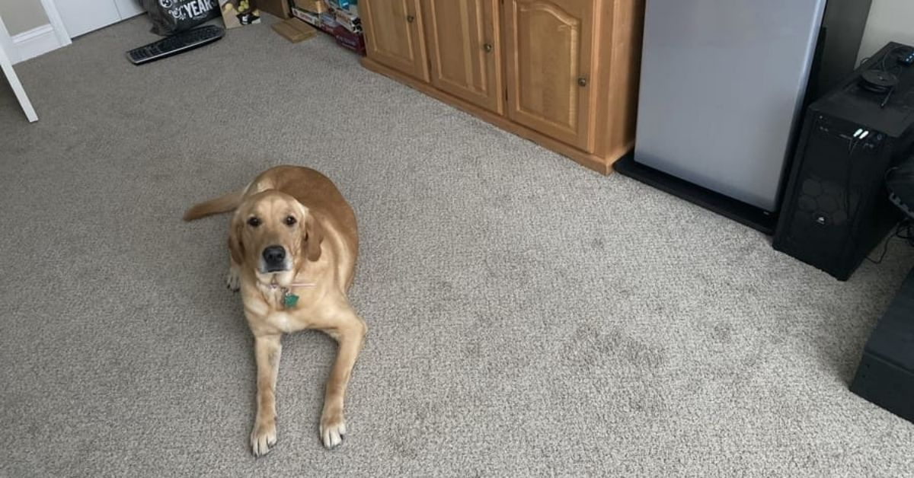
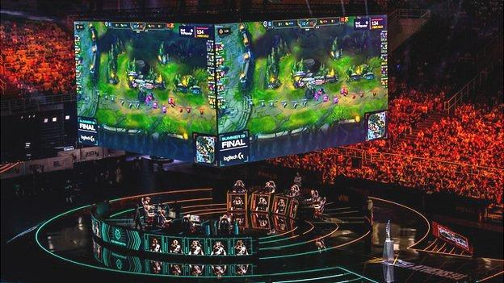
My personal introduction

Slide 3
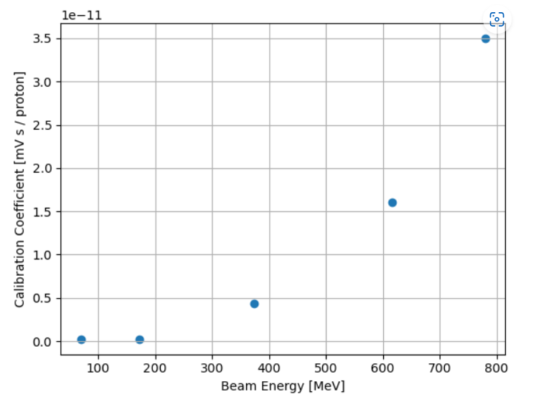
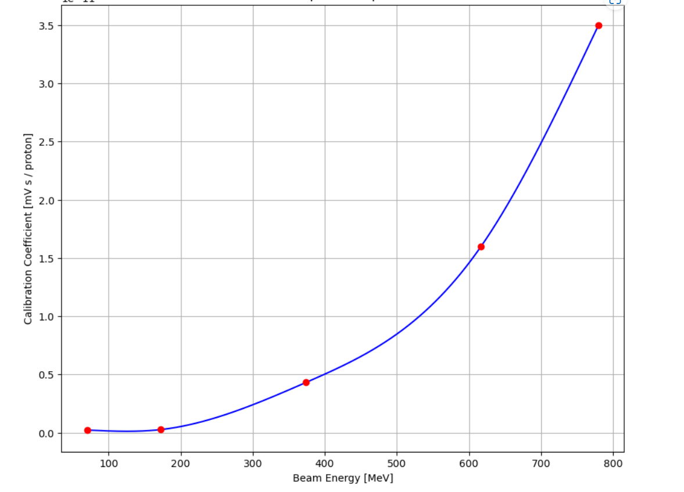
Stage 1 Projects: Group 1F: Interpolation

Slide 4
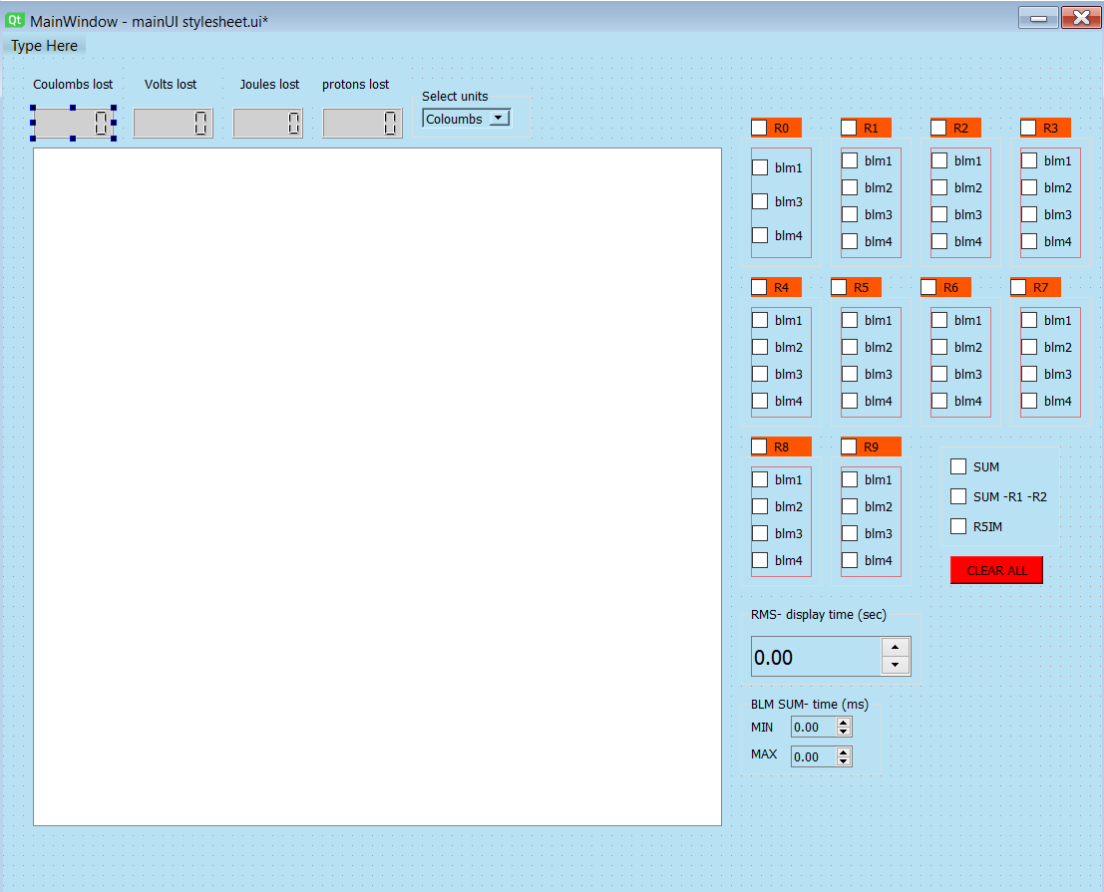
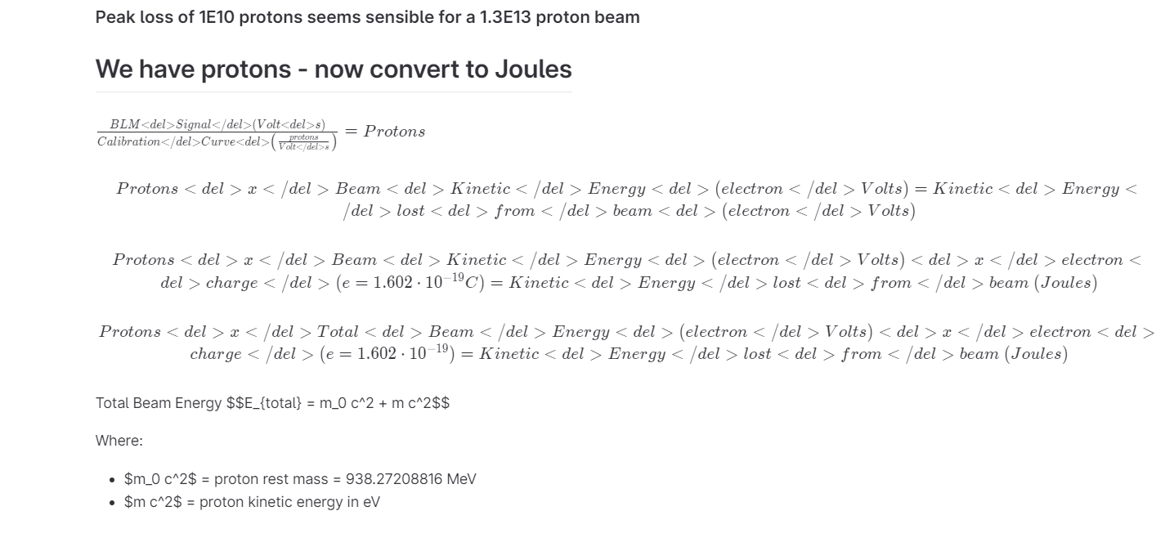
Stage 2 Projects: Waterfall GUI

Slide 5
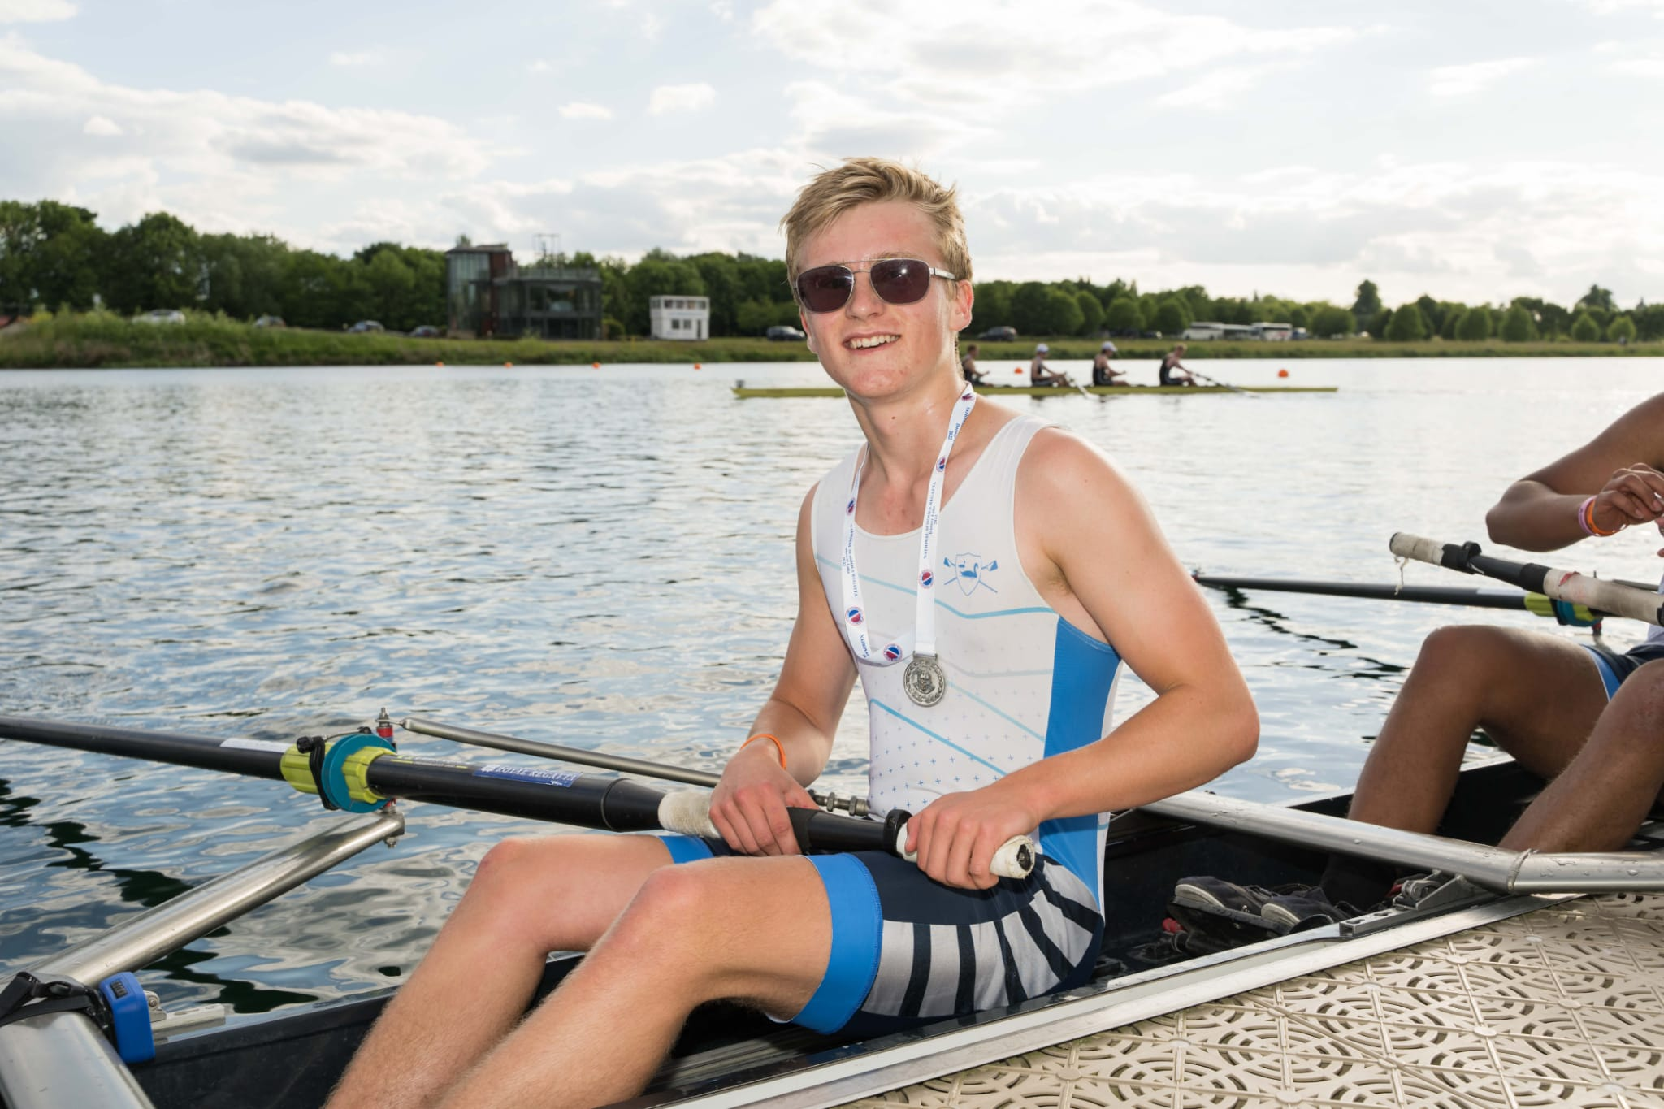
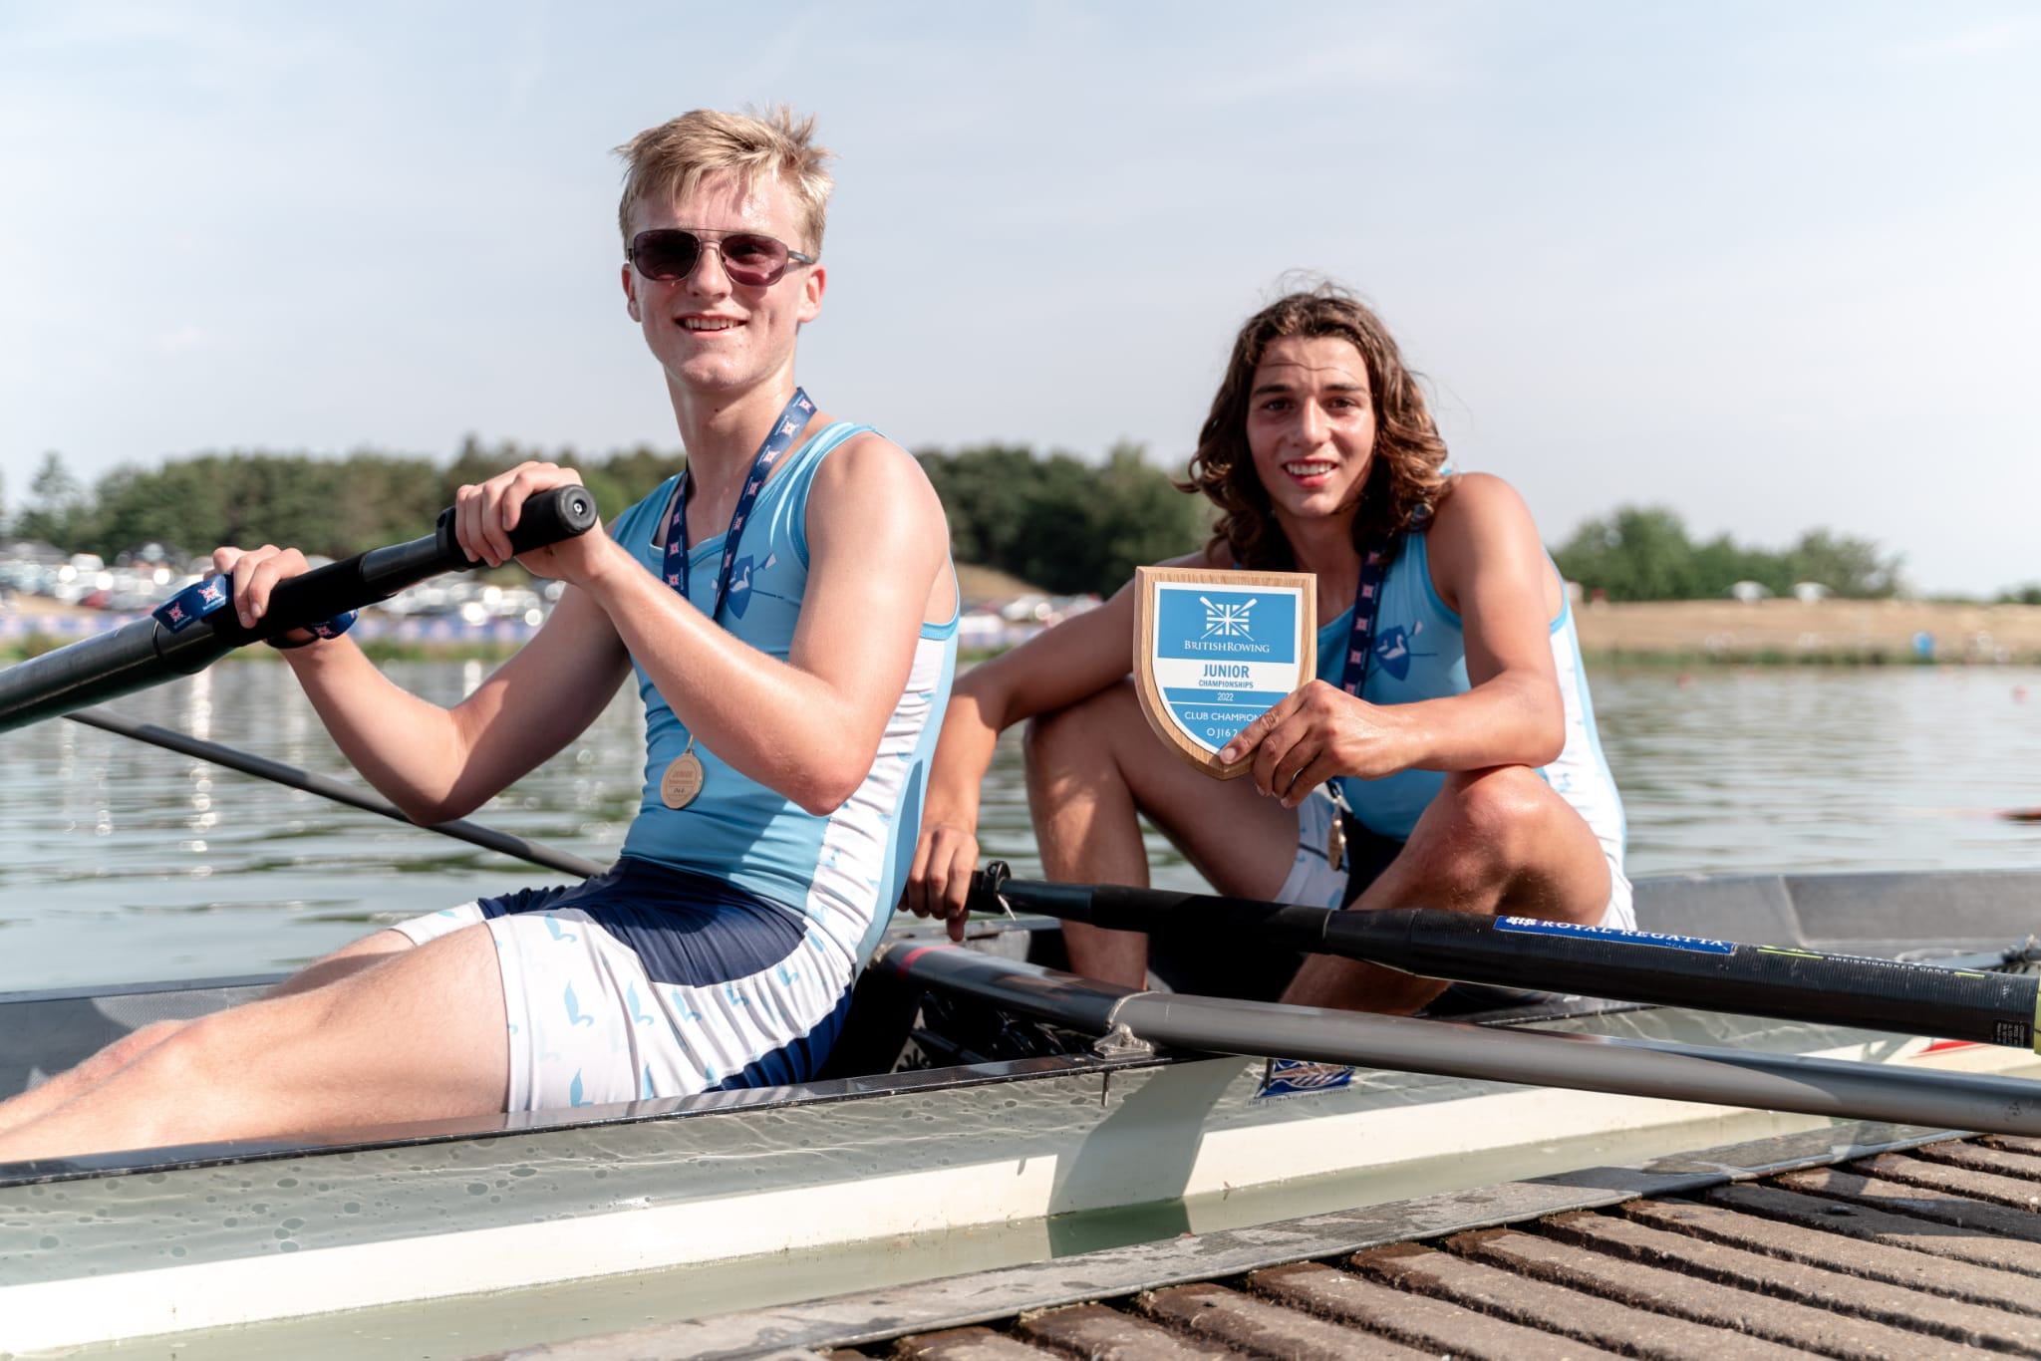
Anton
Among coding and game design I also do a lot of rowing, training 17 hours every week. Last year I won the Junior British rowing championship in the J16 pair and came second at the National schools regatta in the J16 coxed four, but haven’t won any important medals this year.
The work experience has been an amazing opportunity:
I’ve met loads of new people and got on well with them
I’ve learnt loads of new things about python such as matplotlib and pyqt
I’ve developed my problem solving and teamwork skills

Slide 6
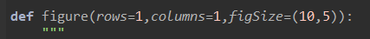
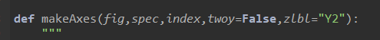
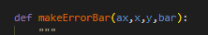
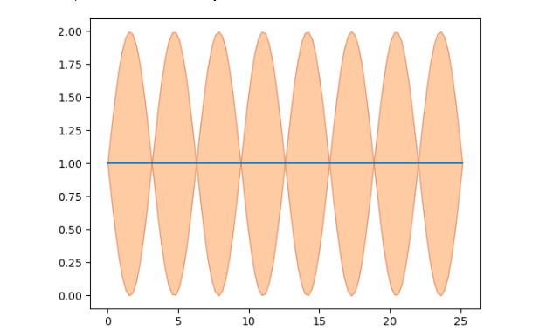
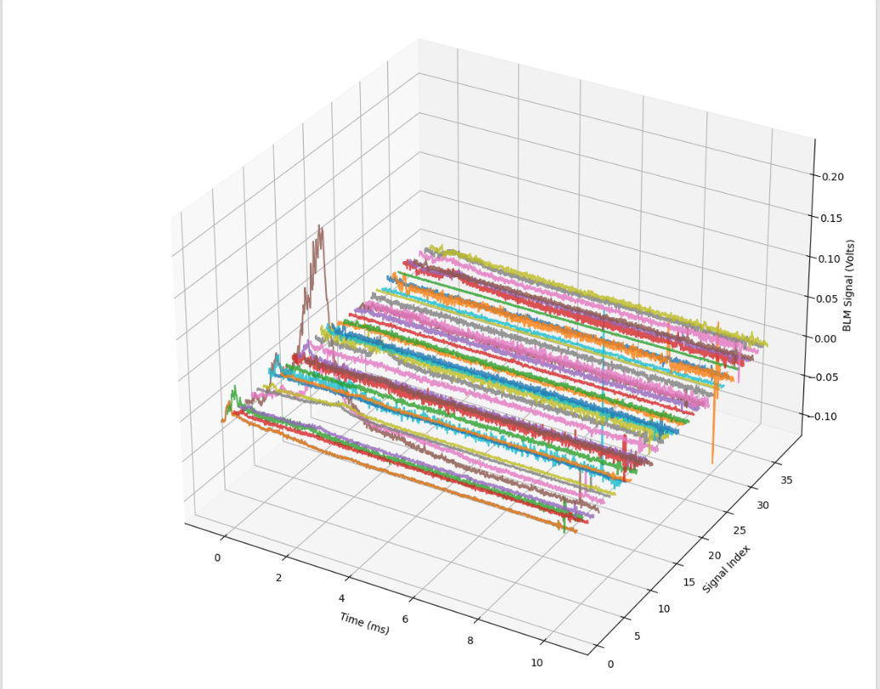
Stage 1 Projects: Group H: Plotting
In my team I coded the Figure(), makeAxes() and plot() functions. These were designed to make plotting in phase 2 a lot easier for everyone.
I had to learn a lot of matplotlib which was completely new to me, it also didn’t help that we had to restart on the third day as we miss-interpreted the project brief.

Slide 7
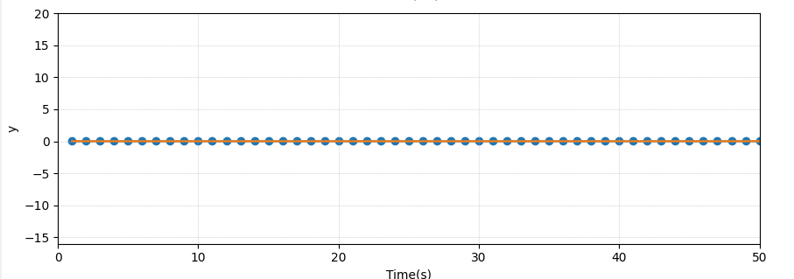
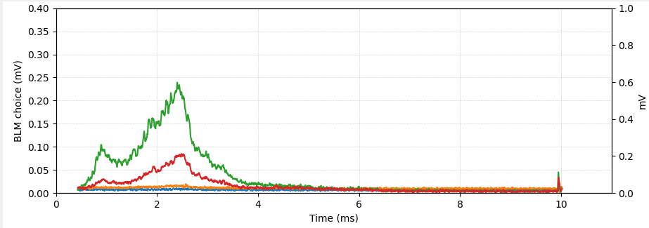
Stage 2 Projects: Loss monitoring and logging
At this stage of the project I continued with what I knew – plotting the graphs but this time in a GUI. I also helped with linking some of the buttons to their features on the graph.
I learnt a lot more about how pyqt worked and how to implement things inside of it.

Slide 8
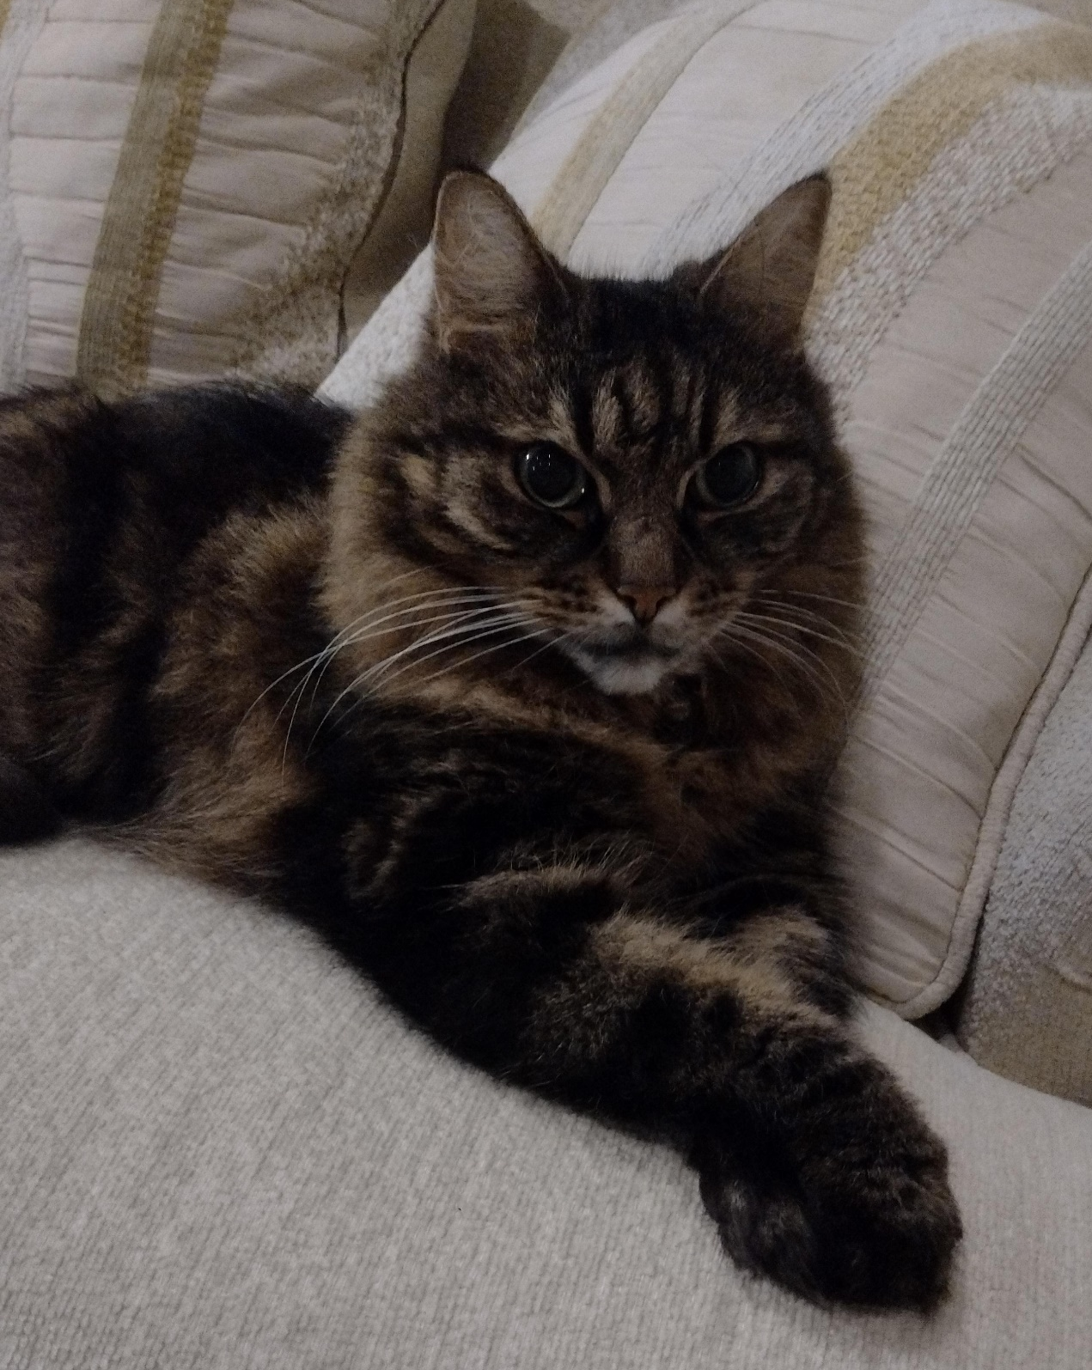
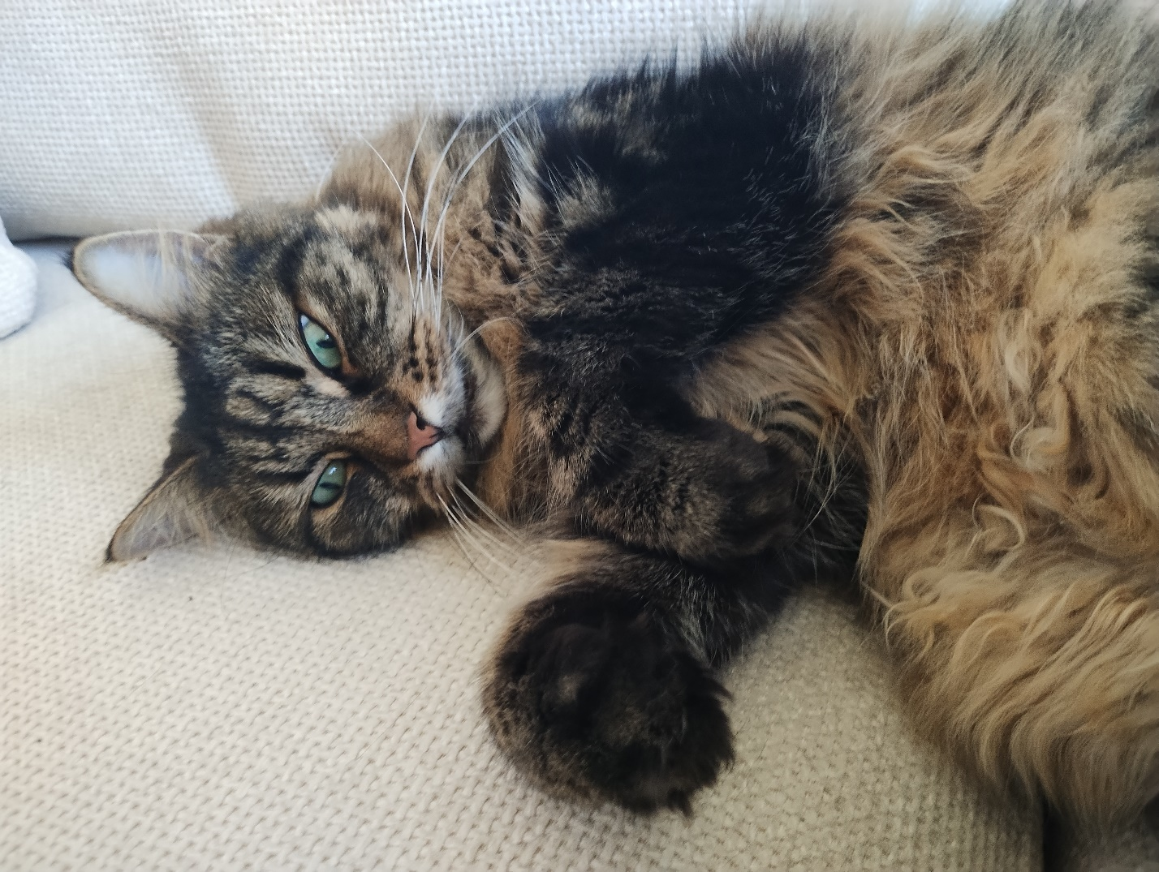
Craig
Maths/programing things
I will teach at my synagogue’s Sunday school (From September)
I am learning Spanish
Learn how to use git with others
How to use PyQt / QT designer

Slide 9
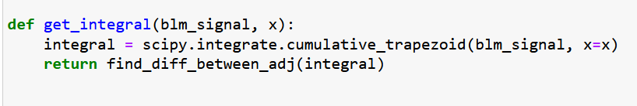
Stage 1 Projects: Group 1G: Integration/unit conversion
We were trying to convert the BLM data into more usable units (protons/joules)
First we researched different method of integration
Then we tried to implement the unit conversion but we could get it to work

Slide 10
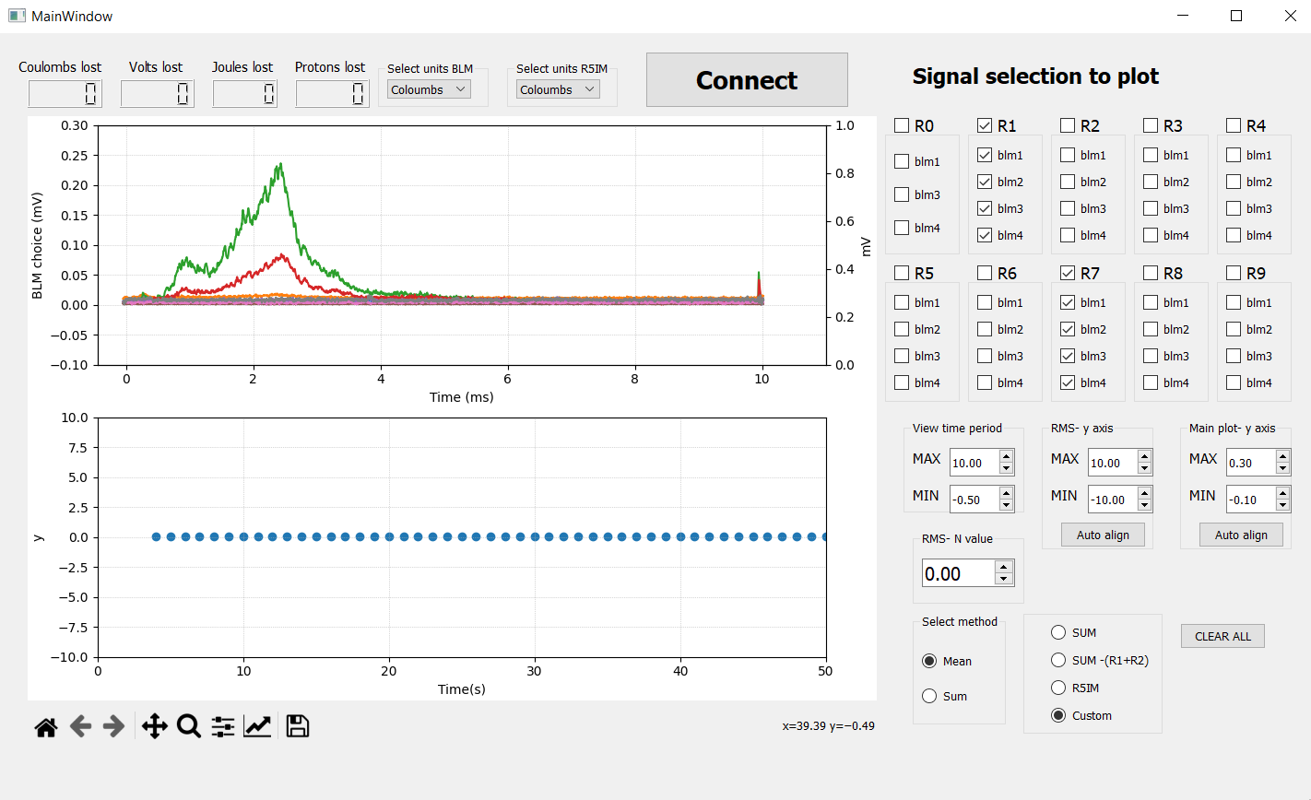
Stage 2 Projects: Loss Monitoring
In stage two I mostly worked on designing the GUI
This is it mostly working

Slide 11
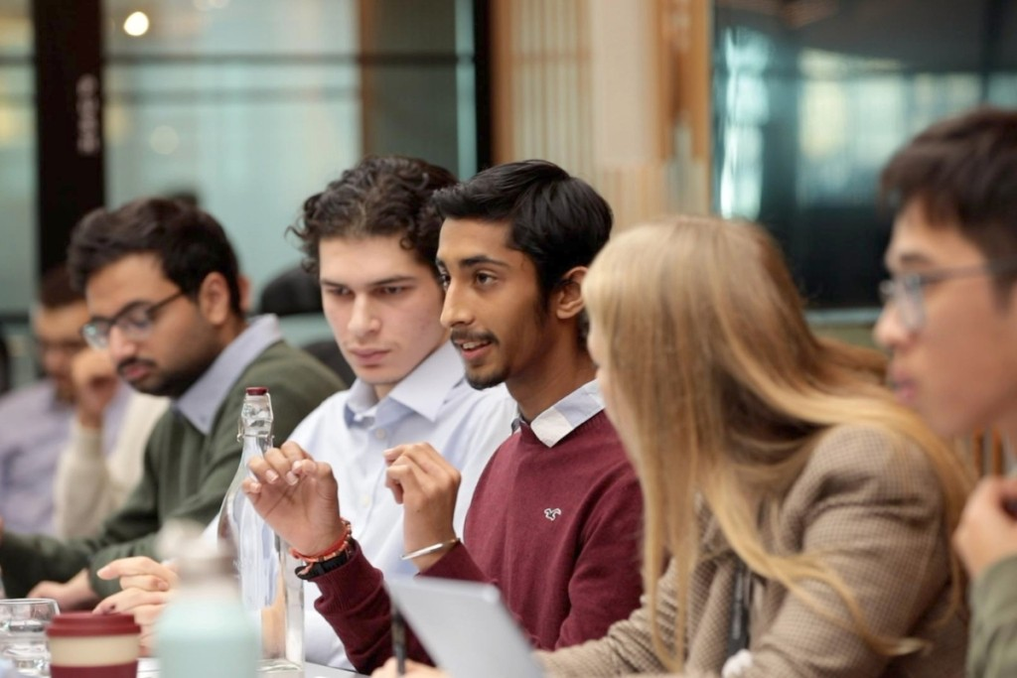
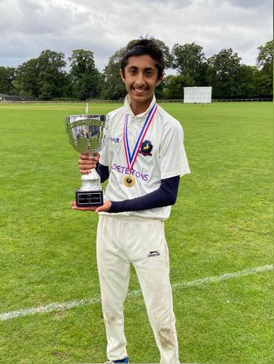
Pranav’s Introduction
Debating
Cricket
Guitar
Biggest learning:
The true nature of Impact and the value of persistence
Favourite Quote:
If your presence doesn’t make an impact, your absence won’t make a difference.
Notes:
Cricket and Guitar as discovering different sides of me.
Perhaps one of the biggest reasons I came here, and everything about what I do is for tangible, real impact on people’s lives. Favourite Quote and idea of impacting other people’s lives drove me to here. But a slightly evolved idea after talking to people and going through experience - impact isn’t the tangible “wow” we see, that’s to make a difference, but true impact is that fulfilled feeling, after constant persistence and touch people’s lives, that is true impact.And this place touches so many people’s lives without them even knowing it. That impact, that true value of persistence, whether it be through 5 hours of troubleshooting, that value of persistence is perhaps my biggest takeaway from the experience.

Slide 12
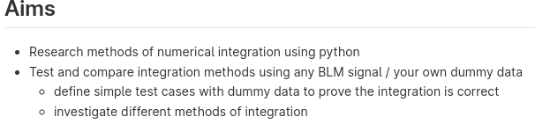
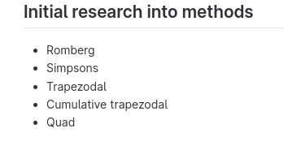
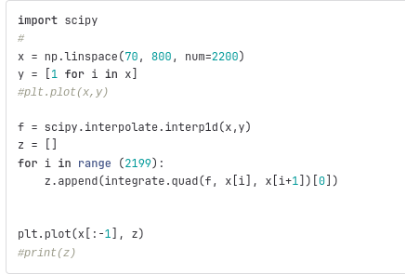
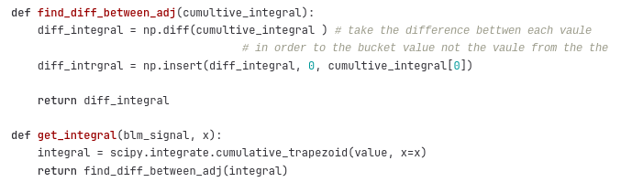
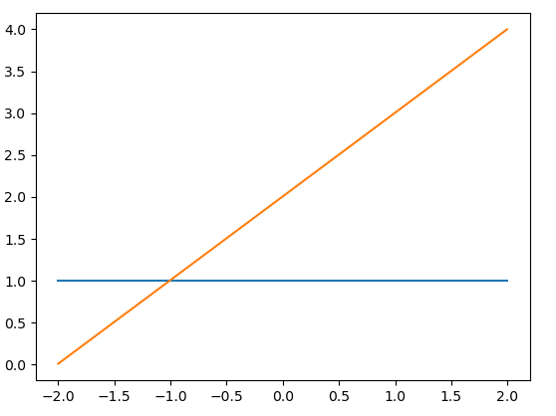
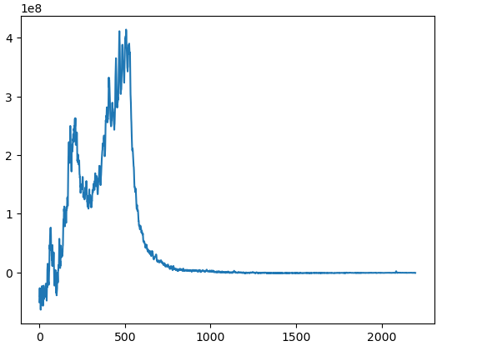
Stage 1 Project - Energy Calibration - Integration and Interpolation of Data using Python

Slide 13
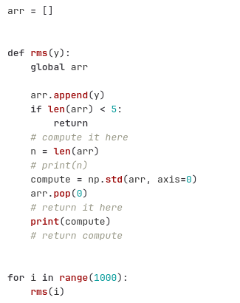
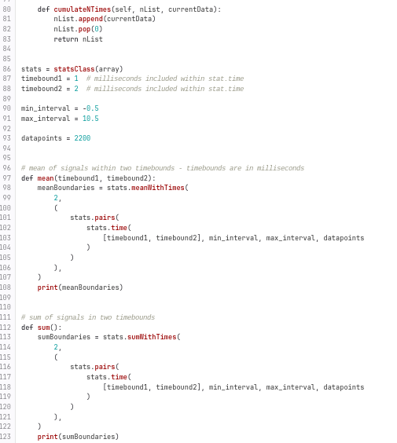
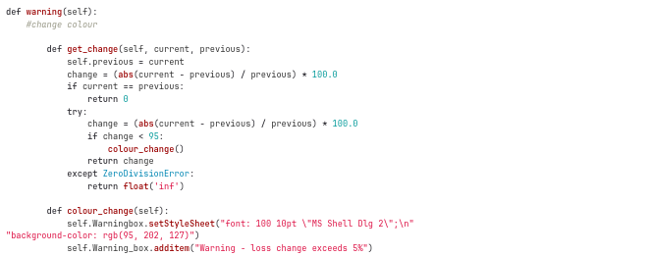
Stage 2 Project - Loss Monitoring
Root, Mean Square Function
Warning dropbox - timestamps and energy loss
Sum and Mean of BLMs

Slide 14
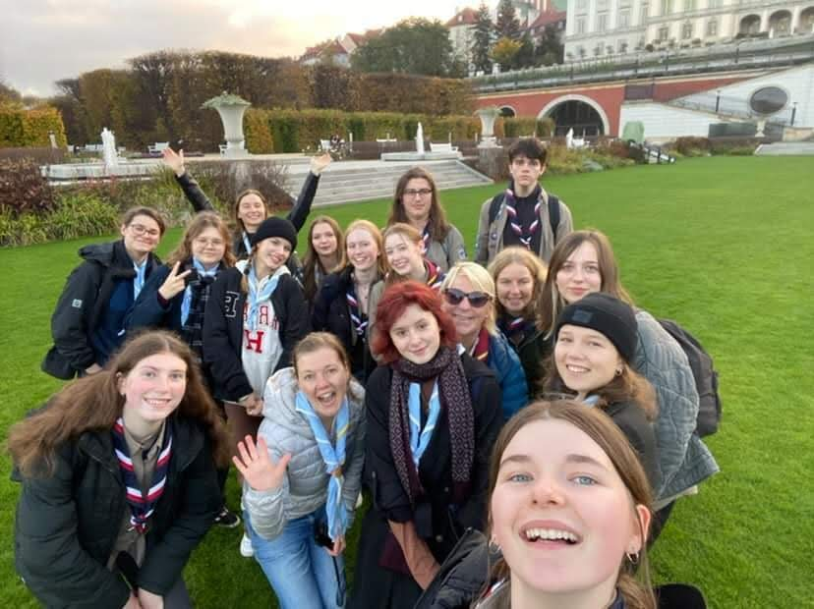
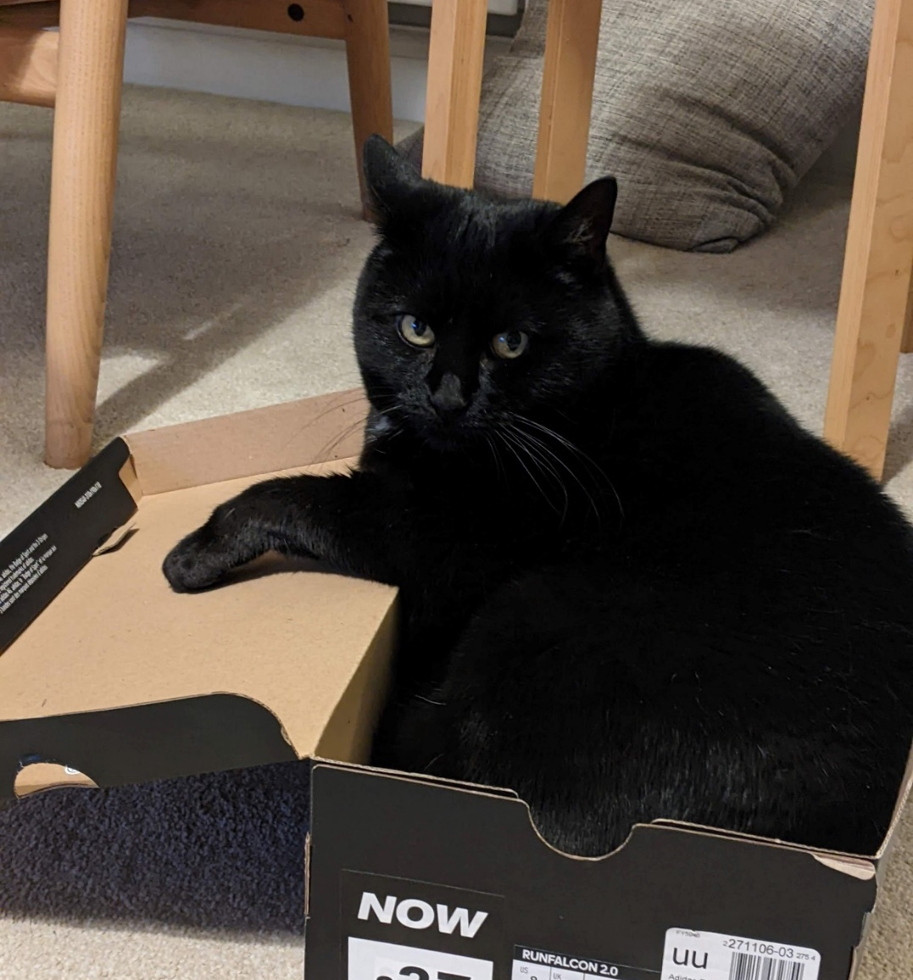
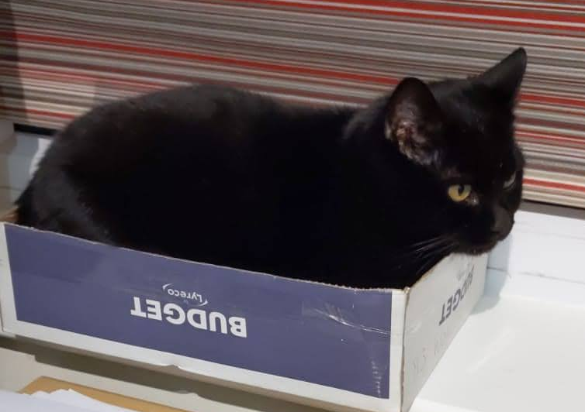
Evelyn
Improved my python skills, learnt a lot from my peers
Learnt how to work more collaboratively – and ask more questions!
Ellie !!

Slide 15
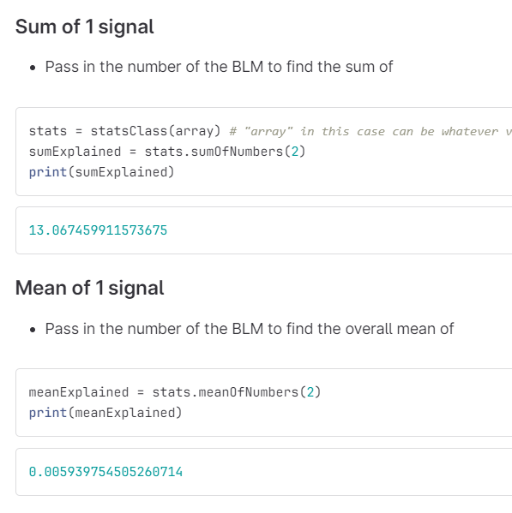
Stage 1 project – Group 1B – Statistics
Initially overwhelmed by the amount of work to do
Struggled to use gitbash at the beginning, hopefully understand it more now
Documented functions for my group – made a ‘how to’ notebook
Enjoyed using maths I had learnt for a real application

Slide 16
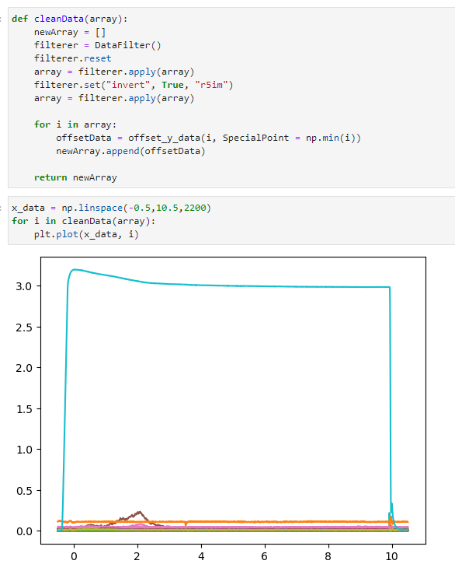
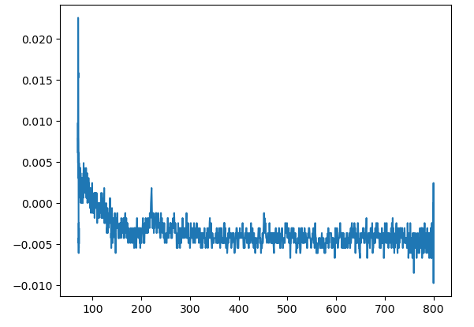
Stage 2 project – Loss tracking
Learnt how to plot graphs
Used functions and skills from first project
Lots of problem solving, learning even more from my peers

Slide 17
Acknowledgments
Thank you to the public engagement team, for letting us use this space (especially the kitchen!) and the laptops that we’ve been working on.
Thank you to the reception team who have had to deal with us every time we forget our name badges.
Thank you to everyone who maintains this space and the site every day and ensures that we have a clean work environment.
And finally thank you to Haroon and Esher for giving up your time to run this opportunity, and for helping us with our projects.
We are so grateful for all the effort they’ve put in, without an expectation of anything in return, they’ve invested so much time and energy into making this experience fantastic and we couldn’t be more grateful.

Slide 18
GUI Demo

Slide 19
Thank you
Questions?

